Slide 1
SOLAR POWERED SMART IRRIGATION SYSTEM
Ministry:- Government of Uttarakhand
Organisation Name:- Agriculture and Rural Development
Problem Statement:- Solar Powered Smart Irrigation System
Team Name:- S.P.A.R.K
Team Leader Name:- Akshiv Agrawal
College Name:- Birla Institute of Technology, Mesra, Jaipur Campus

Slide 2
SOLUTION APPROACH:-
Here we are using renewable resource of energy (i.e. solar energy) to run our motor for supplying water to farm.
Solar energy charges the battery that will run the motors.
Growing crops under controlled environment such as temperature, humidity, and fertilizers with the help of automated systems is called Polyhouse Farming and we are using this technique for our project.
There will be a tank which contain water for the irrigation and it will be connected to motor for supplying water to the crop.
We are using LED, fan for providing required atmosphere for the crop.
Through sensors output, Arduino commands whether the fan, led, motor should be switch ON or OFF.

Slide 3
SOLUTION APPROACH:-
Through sensors output, Arduino commands whether the fan, led, motor should be switch ON or OFF.
Through Bluetooth module, sensors data such as moisture, temperature, PH value will be send directly to our smartphone.
We can also give command through our smartphone to the Arduino.
Crop health’s data will also be send to our smartphone.
Through this data we can change the amount of fertilisers used for irrigation.

Slide 4
TECHNOLOGY STACK:-
We are using Arduino uno as a microcontroller board which will work as a brain of the system.
HC-05 is a Bluetooth module which is designed for wireless communication.
We are using soil moisture sensor which is used to test moisture of soil. As per sensor output water pump will be ON/OFF. When soil moisture is low then pump gets ON.
We are also using temperature sensor which is used to detect temperature of the atmosphere. When temperature sensor gives high output then fan will be on to control the temperature.
LDR sensor is also used here to detect the light. When availability of light is low then LEDs gets ON.
Water level indicator is used to detect level of water in the tankers.
PH sensor is used to detect the acidity of soil.

Slide 5
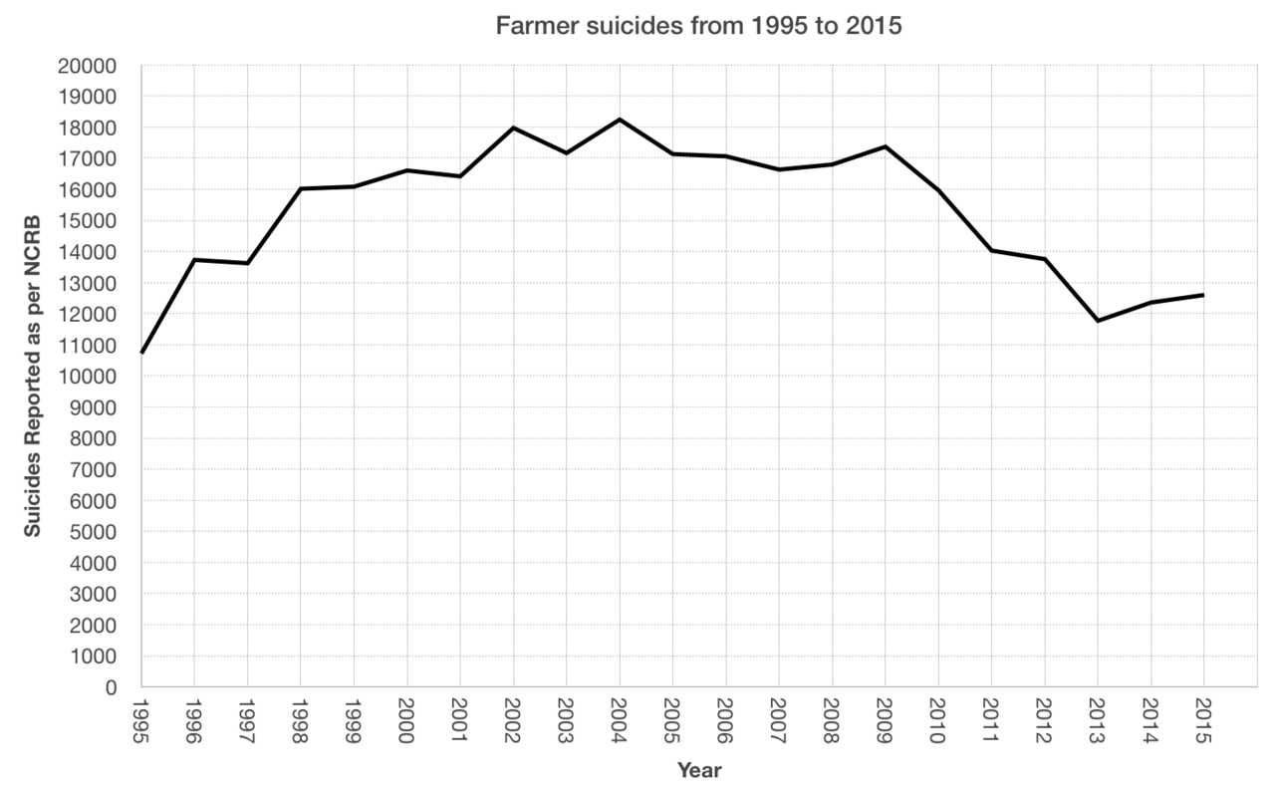
USE CASES:-
In simple technique of farming, farmers completely depends on weather.
A large amount of crops get damaged because of excess raining, high temperature etc.
A large population of farmers suicide because of loan.
In 2019, Post-monsoon rain damage crops in Maharastra, cause losses over 5000 crores.

Slide 6
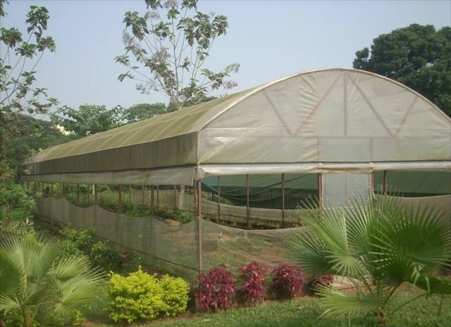
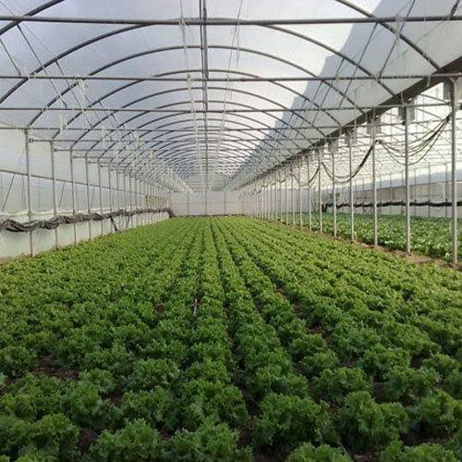
USE CASES:-
Polyhouse farming has some advanages over open field cultivation.
Plants are grown in a controlled environment and crops can be grown throughout the year without depending on the season.
Insects, pests and diseases are less in polyhouse farming and external climate does not have any effect on plant growth.
Quality of produce is high when compared to open field cultivation.
We can use polyhouse cultivation in those areas where temperature in not good for required crops, in rainy areas.
You can get upto 60% of subsidy by government.
Polyhouses are best for raising nursery plants, flower production, ornamental plants.

Slide 7
SHOW STOPPER:-
Most of the polyhouses in the market are manual controlling but our prototype is fully automatic and can be controlled by smartphone.
Data is stored in smartphone which can be used in future.
Most of the polyhouses lack these functions.
We are using solar panels for saving electricity but rest of polyhouses are lacking this technology.
We also using PH sensor for checking health of crops.

Slide 8
THANK YOU

